Slide 1
New type of location API

Slide 2
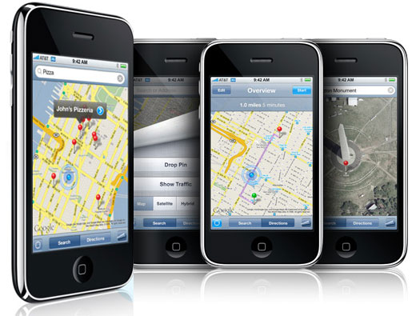
Location Based Services today are smart phone-driven

Slide 3
Lets review the LBS situation:
  Only 18% of phones are smart phones in US
  Growing at 1% per quarter
  Not all smart phones are GPS
  Downloadable application required to get location
  For iPhone, app must be in use

Slide 4
More info to ponder:
  55% of SMSs ask “where are you?” – 65B in ’10
  Thanks to e911, every mobile phone is locatable
  Every CDMA handset has had GPS for better part of the decade – 130M phones!

Slide 5
Every phone is locatable +
Location is the most powerful mobile developer tool
Then why hasn’t this combination been consummated?

Slide 6



Introduce two new concepts in location
1. Ubiquity : locate of 150+M phones on one API
+
+
2. Cloud-based : Location accessed remotely. No downloadable app required.

Slide 7

Location ubiquity + Cloud-based =

Slide 8
Who does ubiquitous cloud-based matter for?
  Network effect applications : social, enterprise
  Marketers and advertisers who need mass
  SMS, mobile web, web, voice

Slide 9
Developer Contest
http://developer.veriplace.com/contest/
First prize:
  $5,000 cash + $2,500 in locates – Best Professional Mode
  $5,000 cash – Best Freedom Mode
Second prize:
  Apple iPad to “best of” category winners

Slide 10
Come see us:
Booth: #5
  Register for Developer Accounts
  Locate your own phone
Our CTO, Scott talking about API @ 2:35 Ballroom V

